Slide 1
Reviews of Reviews: just how meta does it get?
By: Nova Smalley

Slide 2
What is a Review of Reviews
Reviews of reviews and Systematic reviews are very much alike

Slide 3
What are the similarities?
Systematic review
Review of reviews
Use a protocol
Screening process
Data Extraction
Synthesis

Slide 4
So what’s the difference?
Although they are similar, there are two main differences between them
What's being reviewed
Checking overlap

Slide 5
Systematic review
Primary Studies
Primary Studies
Primary Studies
Primary Studies
Primary Studies
Primary Studies
Primary Studies
Primary Studies
Primary Studies
Primary Studies
Primary Studies
Primary Studies

Slide 6
Review of reviews
Systematic review
Systematic review
Systematic review
Systematic review
Systematic review
Systematic review
Systematic review
Systematic review
Systematic review

Slide 7
Overlap
Reviews of reviews analyse systematic reviews
Each of the systematic reviews can overlap
Review 1
Review 2
= Primary studies
Notes:
We must address this as it may affect the conclusions we can draw

Slide 8
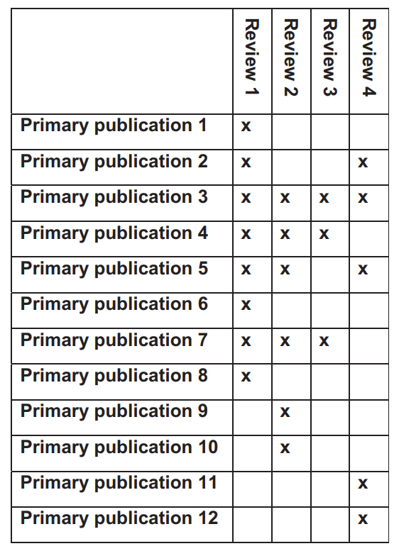
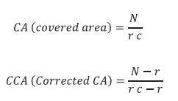
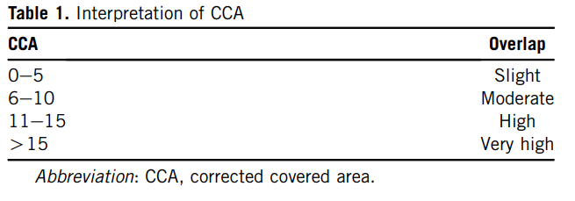
Citation matrices
Screenshots taken from Pieper et al. 2014
Notes:
N is the number of primary publications, r is the number of rows (ie; unique references) and c is the number of reviews within that category

Slide 9
Citation Matrices
Not a perfect solution
If one study has many more primary studies than another it can affect how well the method works
Number of Reviews (c) | Total number of publications (N) | Number of Unique publications (r) | CCA
2 | 189 | 37 | 0%
Notes:
If two publications have a total of 189 references and one of those has 37 even if all of those are overlaps it would be a 0% using the CCA method

Slide 10
How I’m using it
NCD Umbrella review
The goal is to provide an overview of the current coverage by systematic reviews on NCD’s in 7 key areas
Cardiovascular Disease
Cancer
Diabetes
Bone Disease
Mental Health
Chronic respiratory Disease
Cardiovascular Disease

Slide 11
How I’m using it
NCD Umbrella review
The goal is to provide an overview of the current coverage by systematic reviews on NCD’s in 7 key areas
Cardiovascular Disease
Cancer
Diabetes
Bone Disease
Mental Health
Chronic respiratory Disease
Cardiovascular Disease

Slide 12


The end
To contact me or to access the slides again please scan the QR code

Slide 13
Refrences
1. Pieper D, Antoine SL, Mathes T, Neugebauer EAM, Eikermann M. Systematic review finds overlapping reviews were not mentioned in every other overview. Journal of Clinical Epidemiology. 2014 Apr 1;67(4):368–75.

